Slide 1

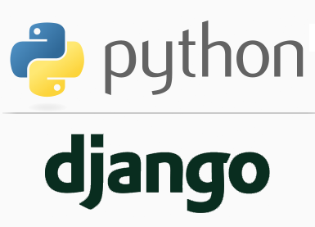
FULL STACK WEB DEVELOPMENT WITH DJANGO
Lecture 7

Slide 2

Today’s Agenda
Developing Our Django App
Introduction To Templates
Benefit Of Templates
Configuring Templates
Steps Needed For Template Based App

Slide 3
Introduction To Templates
In all our previous examples, we set the HTML code in our views.py file of the Django App.
def homePageView(request):
return HttpResponse("<h1>Welcome To Sharma Computer Academy!</h1>")
Although this technique was convenient for the purpose of learning how views work, but it’s not a good idea to hard-code HTML directly into your views.

Slide 4
Introduction To Templates
The reasons are multiple:
Any change to the design of the page requires a change to the Python code. The design of a site tends to change far more frequently than the underlying Python code, so it would be convenient if the design could change without needing to modify the Python code.
Writing Python code and designing HTML are two different disciplines, and most professional web development environments split these responsibilities between separate people. Web Designers (HTML/CSS coders) shouldn’t be required to edit Python code to get their job done.

Slide 5
Introduction To Templates
It’s most efficient if developers can work on Python code and designers can work on HTML and CSS at the same time, rather than one person waiting for the other to finish editing a single file that contains both Python and HTML.
For these reasons, it’s much cleaner and more maintainable to separate the design of the page from the Python code itself.
And this is achieved using Django’s template system

Slide 6
Introduction To Templates
Django template system makes it possible to separate Python and HTML.
The Python code goes in views and HTML code goes in templates.
To link the two, Django relies on the render() function and the Django Template language.

Slide 7
Introduction To Templates
The template will contain the static parts of an html page (parts that are always the same)
Then there are template tags, which have their own special syntax.
This syntax allows you to inject dynamic content that your Django App’s views will produce, effecting the final HTML

Slide 8
Steps Needed For Templating
To create and run a Django app using Templates, we need to follow 11 steps:
Activating Django Environment in VS Code
Creating a Django Project in VS Code
Creating the app
Activating the app
Create the templates directory structure.
Configuring settings.py for templates
Create the HTML file inside the template directory
Creating the view to render the template
Configuring the View in Url
Running the server
Opening the page in browser

Slide 9
Steps Needed For Templating
Amongst these 11 steps , step-1, step-2,step-3, step-4, step 9,step-10 and step-11 will remain as before.
So we will focus only on steps 5,6 ,7 and 8.

Slide 10
Template Directory Structure
There are two main ways to organize our template structure in Django:
the default app-level way and
a custom project-level approach.

Slide 11
Option 1- The App Level Way
By default the Django template loader will look within each app for a templates folder.
And to avoid name conflicts we also need to repeat the app name in a folder below that before adding our template file.
For example, if we had an example_project with a pages app and a home.html template file, the proper structure would be like this:
within the pages app we create a templates directory, then a pages directory, and finally our home.html file

Slide 12
Option 1- The App Level Way
├── example_project
│ ├── __init__.py
│ ├── settings.py
│ ├── urls.py
│ └── wsgi.py
| └── pages
| ├── __init__.py
│ ├── admin.py
│ ├── apps.py
│ ├── models.py
│ ├── tests.py
│ └── views.py
| ├── templates
| ├── pages
| ├── home.html
└── manage.py

Slide 13
Option 2- The Project Level Way
As a Django projects grow in size it’s often more convenient to have all the templates in one place rather than hunting for them within multiple apps.
At first we create a templates directory at the same level as the project.
Within the templates directory create a subdirectory by the name of app for which the template has to be created.
Finally within the app subdirectory create the .html file

Slide 14
Option 1- The App Level Way
├── example_project
│ ├── __init__.py
│ ├── settings.py
│ ├── urls.py
│ └── wsgi.py
| └── pages
| ├── __init__.py
│ ├── admin.py
│ ├── apps.py
│ ├── models.py
│ ├── tests.py
│ └── views.py
| ├── templates
| ├── pages
| ├── home.html
└── manage.py

Slide 15
Option 2- The Project Level Way
However when we do this , we must inform Django about this templates directory.
This is done as follows:
Open the file settings.py
Update the 'DIRS' config under TEMPLATES as follows:
# settings.py
TEMPLATES = [
{ ...
'DIRS': [os.path.join(BASE_DIR, 'templates')],
... },
]

Slide 16
Code Explained
TEMPLATES = [
{ ...
'DIRS': [os.path.join(BASE_DIR, 'templates')],
... },
]
TEMPLATES is a list which contains information about the templates used by this project.
Within the TEMPLATES list , we have a dictionary with a key called DIR.
The value for this key should be the name and path of the templates directory.

Slide 17
Code Explained
TEMPLATES = [
{ ...
'DIRS': [os.path.join(BASE_DIR, 'templates')],
... },
]
BASE_DIR is a variable pre-initialized with the path to the project’s directory. We can view it’s definition at the top of settings.py file as follows:
BASE_DIR = os.path.dirname(os.path.dirname(os.path.abspath(__file__)))
os.path.join() is a function in os.path module which accepts 2 arguments representing the directory path and file name and returns a string containing the complete path

Slide 18
Step 1-Activating Django Environment In VS Code
Before writing our template based app , we must as usual activate virtual environment for our project folder in VS Code.
To do this , follow the steps given below:
Create a project folder anywhere on your computer.
We are creating it in D:\djangoexamples by the name mythirdvsdjangoproject.
So the complete path is D:\djangoexamples\mythirdvsdjangoproject

Slide 19
Step 1-Activating Django Environment In VS Code
Launch VS Code and open the project folder mythirdvsdjangoproject
In VS Code, open the Command Palette (View > Command Palette or (Ctrl+Shift+P)).
Then select the Python: Select Interpreter command:

Slide 20
Step 1-Activating Django Environment In VS Code
The command presents a list of available interpreters that VS Code can locate automatically.
Select the virtual environment in our project folder.
In our case it will be vsdjango
The selected environment appears on the left side of the VS Code status bar, and notice the "(virtualenv)" indicator that tells you that you're using a virtual environment:

Slide 21
Step 1-Activating Django Environment In VS Code
Run Terminal: New Terminal (Ctrl+Shift+`) from the Command Palette, which creates a terminal and automatically activates the virtual environment by running its activation script.

Slide 22
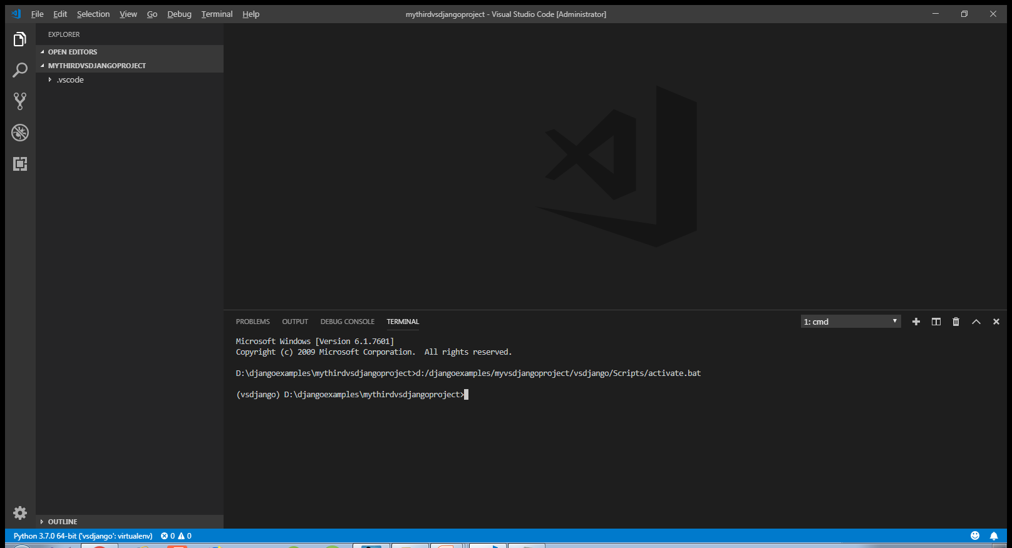
Step 1-Activating Django Environment In VS Code

Slide 23
Step 1-Activating Django Environment In VS Code
Now check whether django has been properly installed or not by running the following command in the directory mythirdvsdjangoproject:
python –m django --version
The response should be the current Django version which as of now is 2.1.7

Slide 24
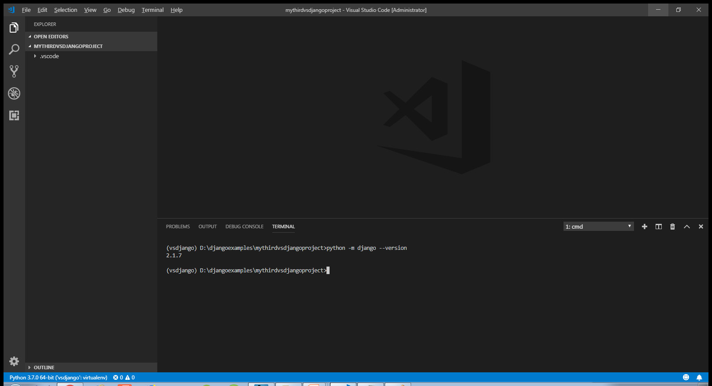
Step 1-Activating Django Environment In VS Code

Slide 25
Step 2-Creating Django Project In VS Code
Now the next task is to create the Django project, which is done by typing the following command at VS Code terminal in the mythirdvsdjangoproject directory:
django-admin startproject templateproject
Doing this will generate the same file/folder structure as we saw before

Slide 26
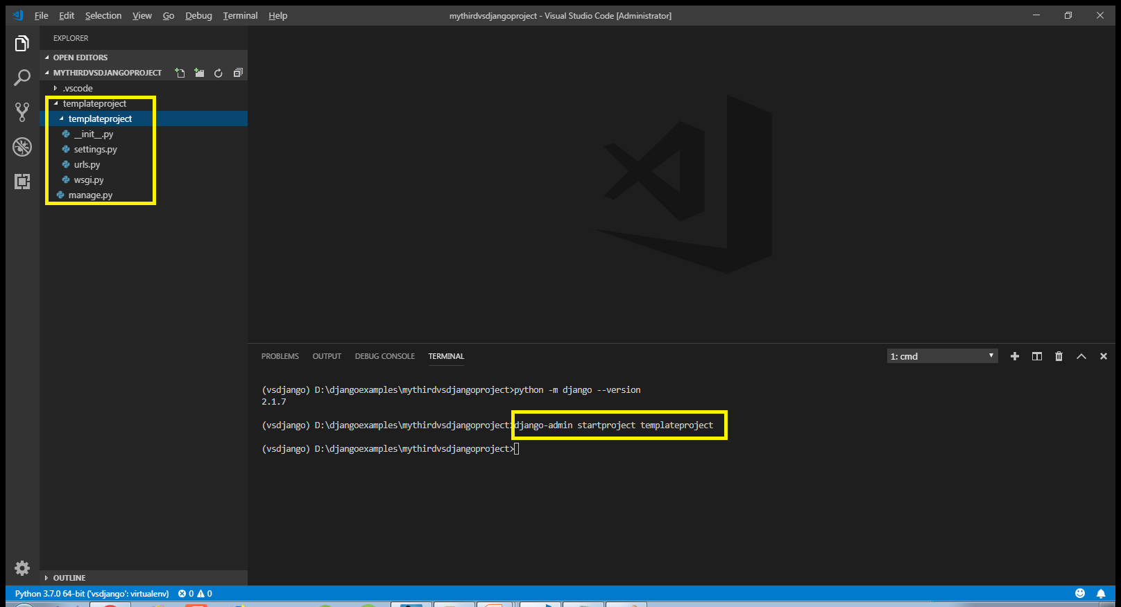
Step 2-Creating Django Project In VS Code

Slide 27
Step 3- Creating The App
As before we must create an app inside our templateproject folder by using the following command :
django-admin startapp appname
where appname is the name of our Django app
In our case , we will call the app as templateapp. For example:
django-admin startapp templateapp
The above command has to be executed from the directory which contains the file manage.py
When we execute the above command Django will create appropriate file/folder structure for our app

Slide 28
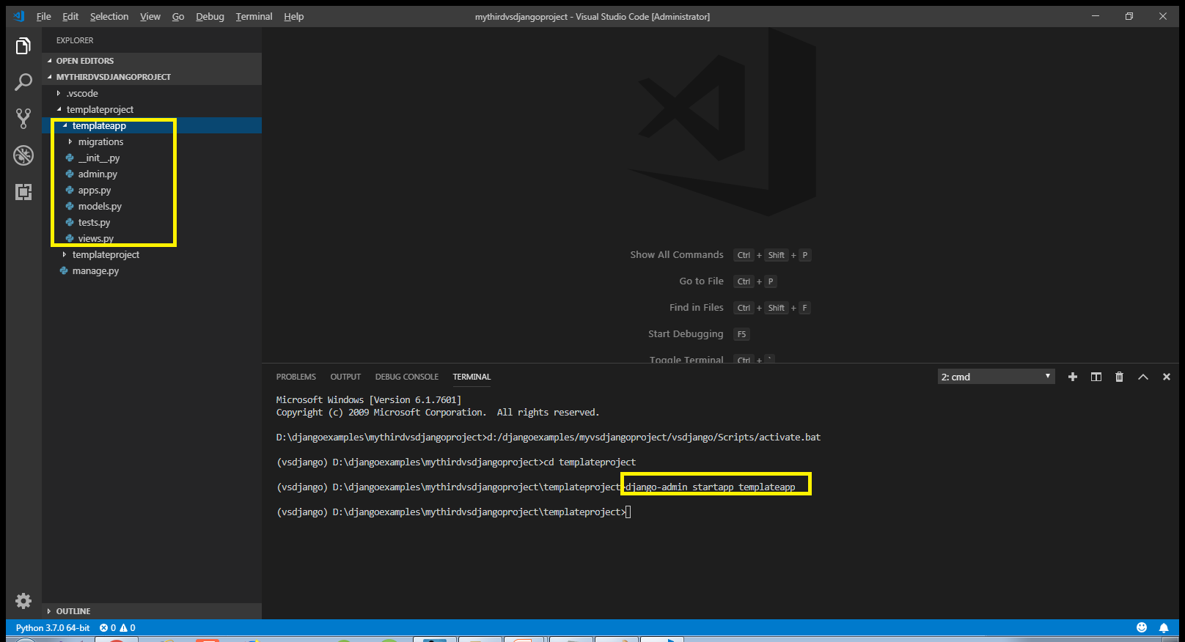
Step 3- Creating The App

Slide 29
Step 4: Activating The App
As done before , after creating the app we must let Django know about it by making the entry in the INSTALLED_APPS list of the settings.py file of the default app given by Django.

Slide 30
Step 4: Activating The App
Open the settings.py file in the templateproject app of our templateproject folder and make the entry shown in green color in the INSTALLED_APPS list
Code:
INSTALLED_APPS = [
'django.contrib.admin',
'django.contrib.auth',
'django.contrib.contenttypes',
'django.contrib.sessions',
'django.contrib.messages',
'django.contrib.staticfiles',
‘templateapp',
]

Slide 31
Step 5: Creating The templates Directory
The next step is to create the template folder structure .
Now since we are using the project level approach of using templates , so we must follow the below mentioned steps as discussed before:
Go to the main project folder called templateproject and create a folder there called templates
This can simply be done by choosing create folder option of VS Code
Now inside templates folder , create a folder called templateapp

Slide 32
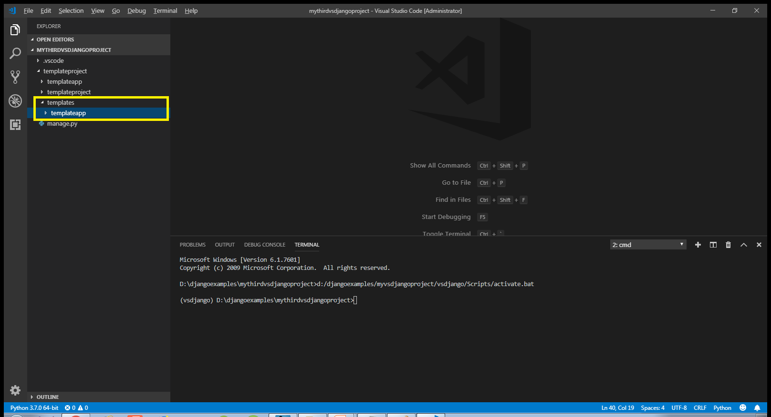
Step 5: Creating The templates Directory

Slide 33
Step 6: Updating The settings.py File
As discussed previously , if we are using project level templates folder , then we must inform Django about it.
To do this we must follow the following steps:
Open the settings.py file in the templateproject app
Locate the TEMPLATES list and modify it’s DIR key as shown below:
TEMPLATES = [
{ ...
'DIRS': [os.path.join(BASE_DIR, 'templates')],
... },
]

Slide 34
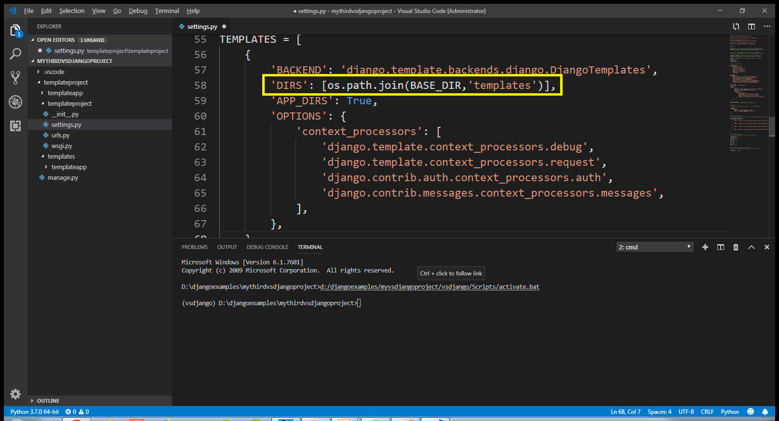
Step 6: Updating The settings.py File

Slide 35
Step 7: Creating The HTML File
Once we’ve done creating templates folder structure then we can create an html file called index.html inside of the templates/templateapp directory.
Initially we will only keep HTML data in this file but later on we will insert template tags (a.k.a Django Template Variable).
These template variables will allow us to inject content into the HTML directly from Django views!

Slide 36
Step 7: Creating The HTML File
#index.html
<!DOCTYPE html>
<html lang="en">
<head>
<meta charset="UTF-8">
<meta name="viewport" content="width=device-width, initial-scale=1.0">
<meta http-equiv="X-UA-Compatible" content="ie=edge">
<title>Template Demo</title>
</head>
<body>
<h1>Hello from templates!!</h1>
</body>
</html>

Slide 37
Step 8:Creating The View
Now we have the template in place, we need to update our views.py.
Previously we simply returned some HTML text from our views.py file, but when we wish to use a template, Django first must do 3 things:
Load the template.
Create a context— which is basically a dictionary of variables and associated data that is passed from view to template and from template to the browser.
Return an HttpResponse.

Slide 38
Step 8:Creating The View
To do all this stuff Django provides us a function called render() which provides a shortcut that allows us to do all three steps in a single function.
When we supply the original request, the template and the context directly to render(), it returns the appropriately formatted response without us having to code the intermediate steps.

Slide 39
Step 8:Creating The View
In our modified views.py, we are simply returning the original request object from the browser and the name of our site template. We will be getting to the context a bit later.
views.py
from django.shortcuts import render
def homePageView(request):
return render(request,'templateapp/index.html')

Slide 40
Step 9:Configuring The View In Url
After creating and updating the views.py as shown in the previous slide we need to tell Django this is the view we want displayed when someone navigates to the site root (home page).
As usual we do this by configuring our URLs at 2 places:
Inside the templateapp directory’s urls.py file
Inside the site’s main urls.py

Slide 41
Step 9:Configuring The View In Url
In the VS Code create a new file called urls.py in the templateapp folder and write the following code in it.
Code (templateapp/urls.py):
from django.urls import path
from . import views
urlpatterns = [
path('', views.homePageView, name =' index'),
]

Slide 42
Step 9:Configuring The Sites Main urls.py File
As we know whenever a request arrives it first hits the main urls.py file , that is , the file urls.py in the directory templateproject.
So we must configure this file also so that it simply redirects the request to our templateapp’s urls.py file whenever a request arrives

Slide 43
Step 9:Configuring The Sites Main urls.py File
In the VS Code open the file called urls.py in the templateproject folder and update the code in it as shown below in green.
Code (templateproject/urls.py):
from django.contrib import admin
from django.urls import path,include
urlpatterns = [
path('admin/', admin.site.urls),
path('',include('templateapp.urls')),
]

Slide 44
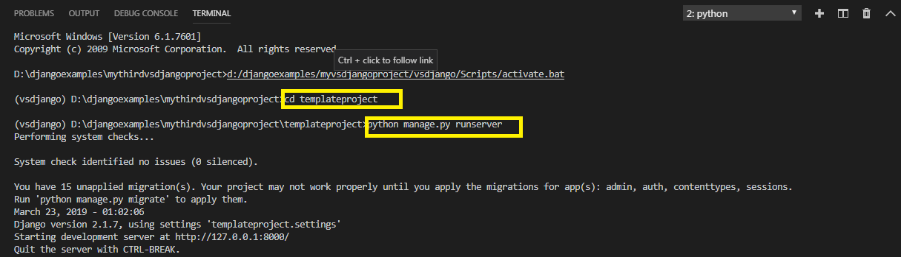
Step 10:Running The Server
To run our new templateapp , go to the folder templateproject by using cd command and type the runserver command in VS Code terminal
cd templateproject
python manage.py runserver.
The server runs on the default port 8000, and we’ll see output like the following output in the terminal window:

Slide 45
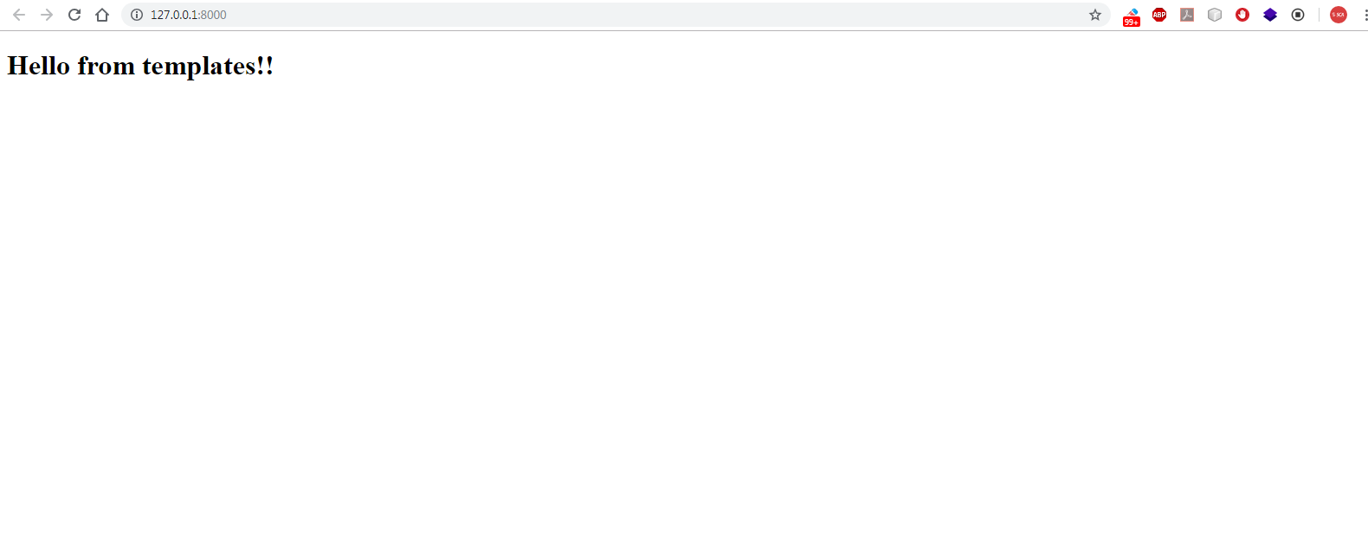
Step 11: Opening The Page
Ctrl+click the http://127.0.0.1:8000/ URL in the terminal output window to open default browser to that address. Now we should see a template based home page

Slide 46
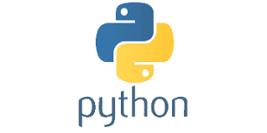
Exercise
Write a Django App using templates which displays the message Help Page
Do the following:
Create a templates directory and connect it to the settings.py file
Create a new view called help and use url mapping to render it for any page with the extension /help
Return the message “Help Page” from your template html file.

